Slide 1
Chapter 6
Safe Dosage Calculations

Slide 2
Introduction
Calculation, preparation, and administration of safe dosages
  Key principle: do no harm
    Medication must be administered exactly as prescribed and in the appropriate dose
Unit-dose form
  Each individual dose of medicine is prepackaged in a separate packet, vial, or prefilled syringe

Slide 3
Calculation Guidelines
Know basic arithmetic
Take meticulous care with all calculations
Calculate ordered dosage from what is on hand
  Check whether measures are in the same system and convert if necessary
  Write the problem in an equation and complete the necessary calculations
  Check accuracy and have someone verify

Slide 4
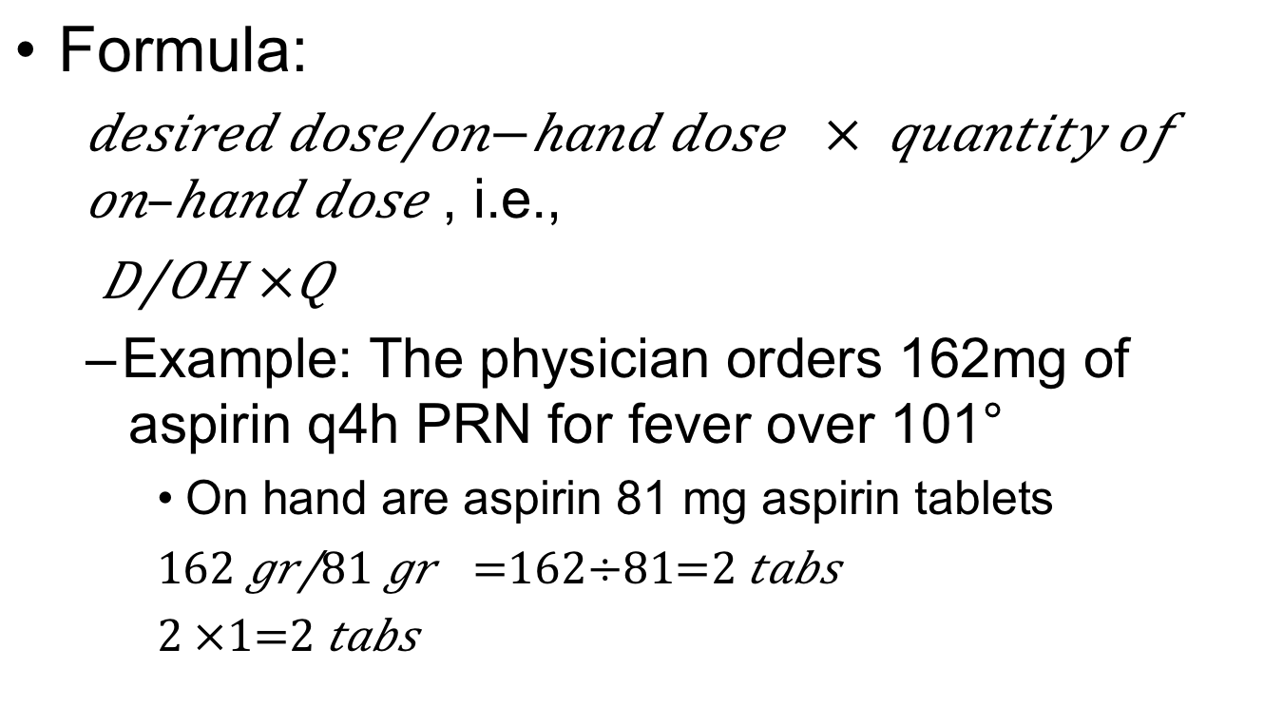
Method 1: Basic Calculation
Formula:
  $\frac{desired dose}{on−hand dose }$ $× quantity of on–hand dose$ , i.e.,
  $\frac{D}{OH}×Q$
  Example: The physician orders 162mg of aspirin q4h PRN for fever over 101°
    On hand are aspirin 81 mg aspirin tablets
    $\frac{162 gr}{81 gr}$ $=162÷81=2 tabs$
    $$2 ×1=2 tabs$$

Slide 5
Method 1: Basic Calculation (cont’d.)
What are the cautions for this method?
  Label all parts of the formula
  Use the same label for desired and on-hand doses
  Use the same label for the quantity and the answer (the amount to be given)
  Reduce fractions to lowest terms before dividing

Slide 6
Method 1: Basic Calculation (cont’d.)
  Multiply by the quantity after dividing
  Take extra care with decimals
  Convert fractions to decimals
  Round off decimals to one decimal place after computation is complete
  Verify the accuracy of calculations with an instructor
  Question the answer if not within normal limits

Slide 7
Method 2: Ratio and Proportion
A ratio describes a relationship between two numbers
  Example: 1 g : 15 gr
A proportion consists of two ratios that are equal
  Example: 1 g : 15 gr = 2 g : 30 gr

Slide 8
Method 2: Ratio and Proportion (cont’d.)
Procedure
  Always label each term in the equation
  Terms of each ratio must be in the same sequence
  Set up the formula with known terms on the left and desired and unknown terms on the right
known unit | : | known | = | desired unit | : | unknown
of measure |  | equivalent |  | of measure |  | equivalent

Slide 9
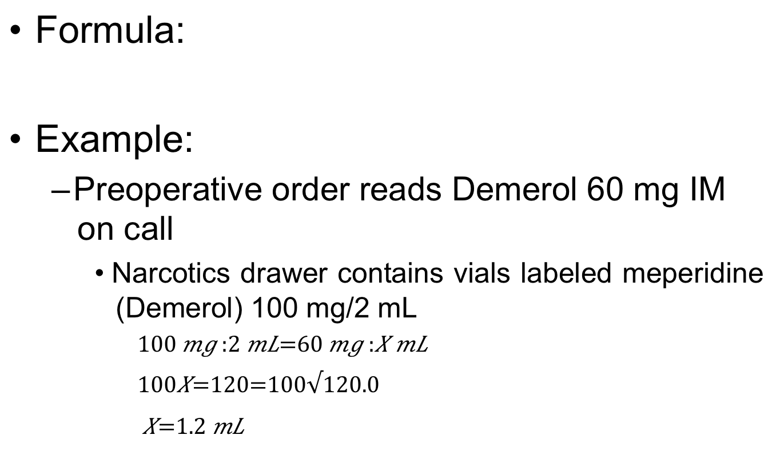
Method 2: Ratio and Proportion (cont’d.)
Formula:
Example:
  Preoperative order reads Demerol 60 mg IM on call
    Narcotics drawer contains vials labeled meperidine (Demerol) 100 mg/2 mL
dose | : | known | = | dose | : | unknown
on hand |  | quantity |  | desired |  | quantity

Slide 10
Method 2: Ratio and Proportion (cont’d.)
What are the cautions for this method?
  Label all parts of the equation
  Ratio on the left contains the known quantity, and ratio on the right contains desired and unknown quantities
  Terms of second ratio must be in the same sequence as those in first ratio
  Multiply extremes first and then the means
  Take extra care with decimals

Slide 11
Method 2: Ratio and Proportion (cont’d.)
  Convert fractions to decimals
  Round off decimals to one decimal place
  Label the answer
  Verify the accuracy of calculations with an instructor
  Question any unusual dosage not within normal limits

Slide 12
Pediatric Dosage
Children are not miniature adults
  Appropriate dosage must take into consideration age, weight, sex, and metabolic, pathological, or psychological conditions
    Always refer to recommended dosages as listed in drug inserts, Physicians’ Desk Reference (PDR), or AHFS Drug Information (AHFS DI)

Slide 13
Pediatric Dosage (cont’d.)
Example:
  Recommended dose of meperidine (Demerol) is 6 mg/kg/24 h for pain, in divided doses every four to six hours, as necessary
  Demerol is available in ampules or cartridges labeled 50 mg/mL
  How much Demerol would be appropriate for a 33-pound child as a single dose every six hours?

Slide 14
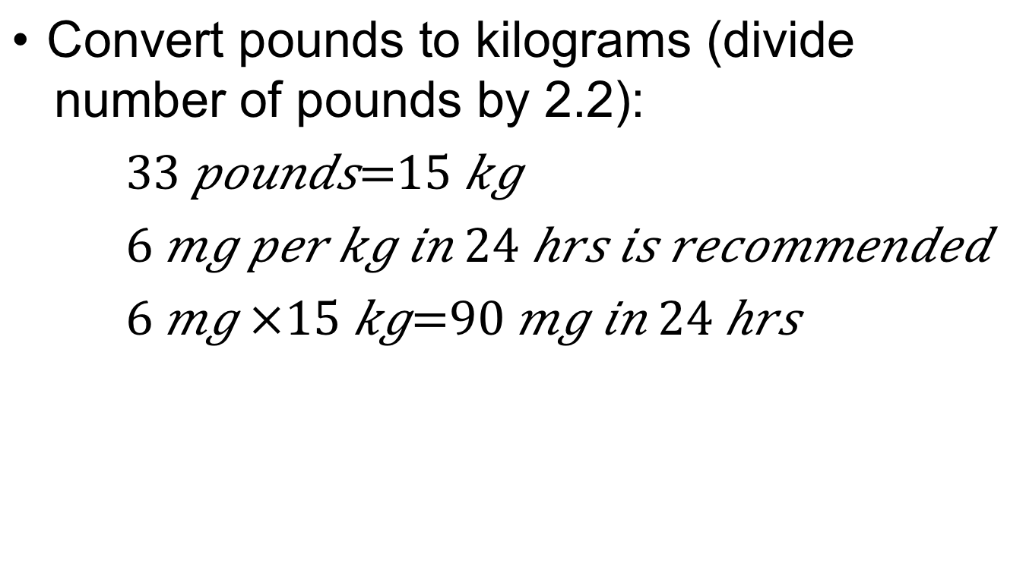
Pediatric Dosage (cont’d.)
Convert pounds to kilograms (divide number of pounds by 2.2):
$33 pounds=15 kg$
$6 mg per kg in 24 hrs is recommended$
$$6 mg ×15 kg=90 mg in 24 hrs$$

Slide 15
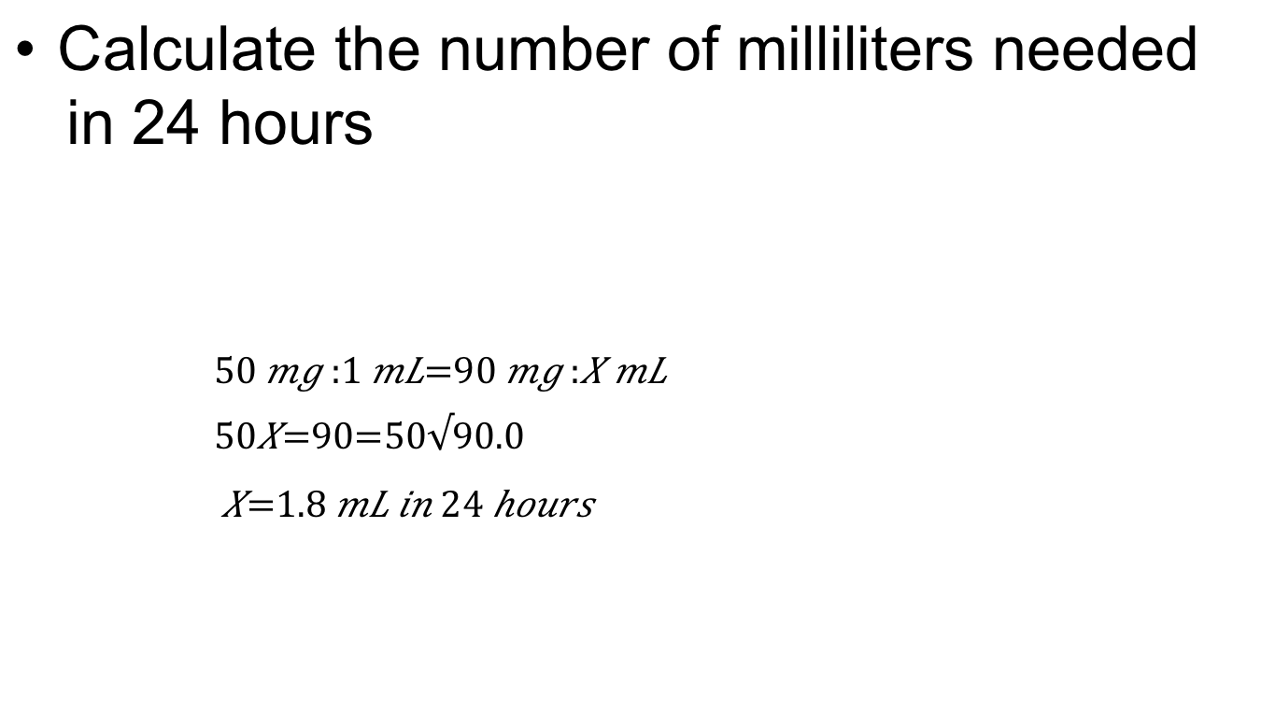
Pediatric Dosage (cont’d.)
Calculate the number of milliliters needed in 24 hours
      $$50 mg :1 mL=90 mg :X mL$$
      $50X=90=50√90.0$
      $X=1.8 mL in 24 hours$
dose | : | known | = | dose | : | unknown
on hand |  | quantity |  | desired |  | quantity

Slide 16

Pediatric Dosage (cont’d.)
Calculate the number of milliliters needed in six hours
      $$24 h :1.8 mL=six hours :X mL$$
      $24X=10.8=24√10.80$
      $$X=0.45 mL dose every six hours$$

Slide 17
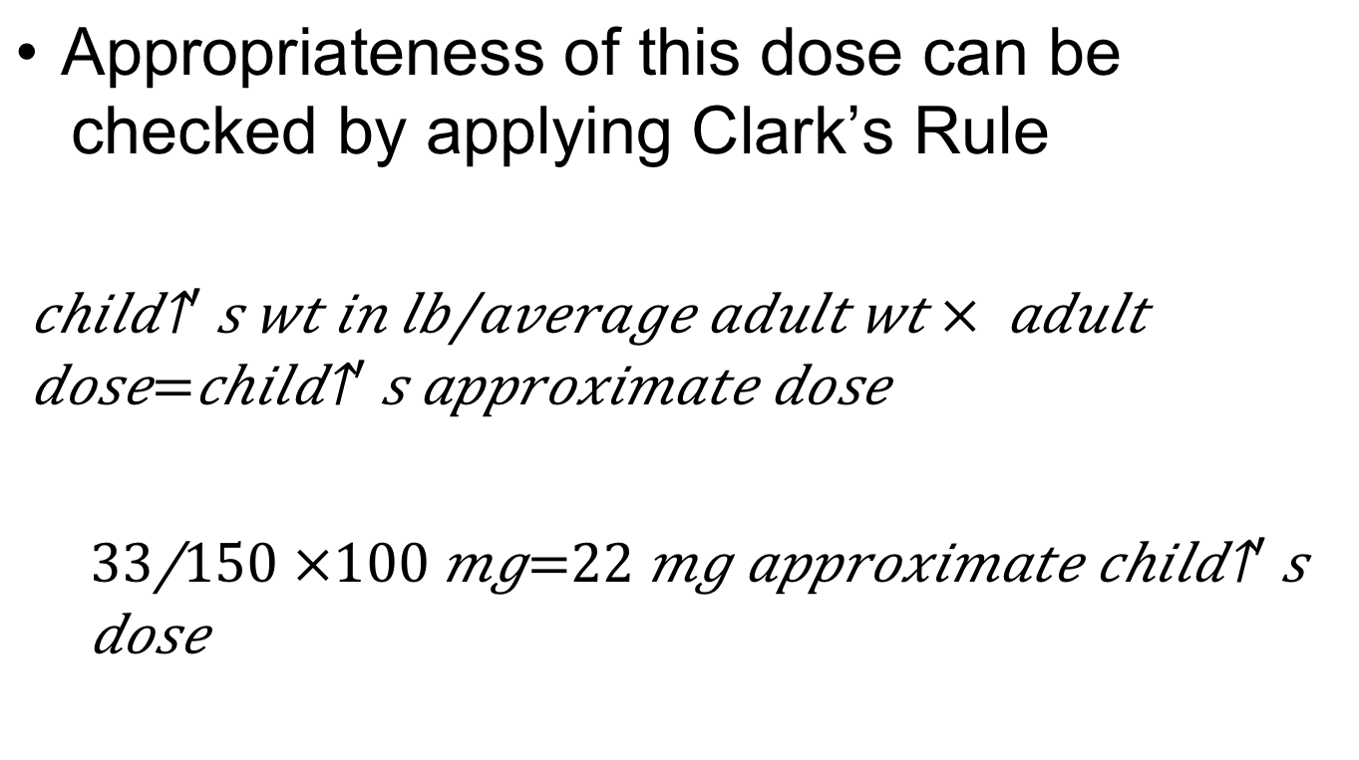
Pediatric Dosage (cont’d.)
Appropriateness of this dose can be checked by applying Clark’s Rule
  $$\frac{child^{′}s wt in lb}{average adult wt}× adult dose=child^{′}s approximate dose$$
  $$\frac{33}{150}×100 mg=22 mg approximate child^{′}s dose$$

Slide 18
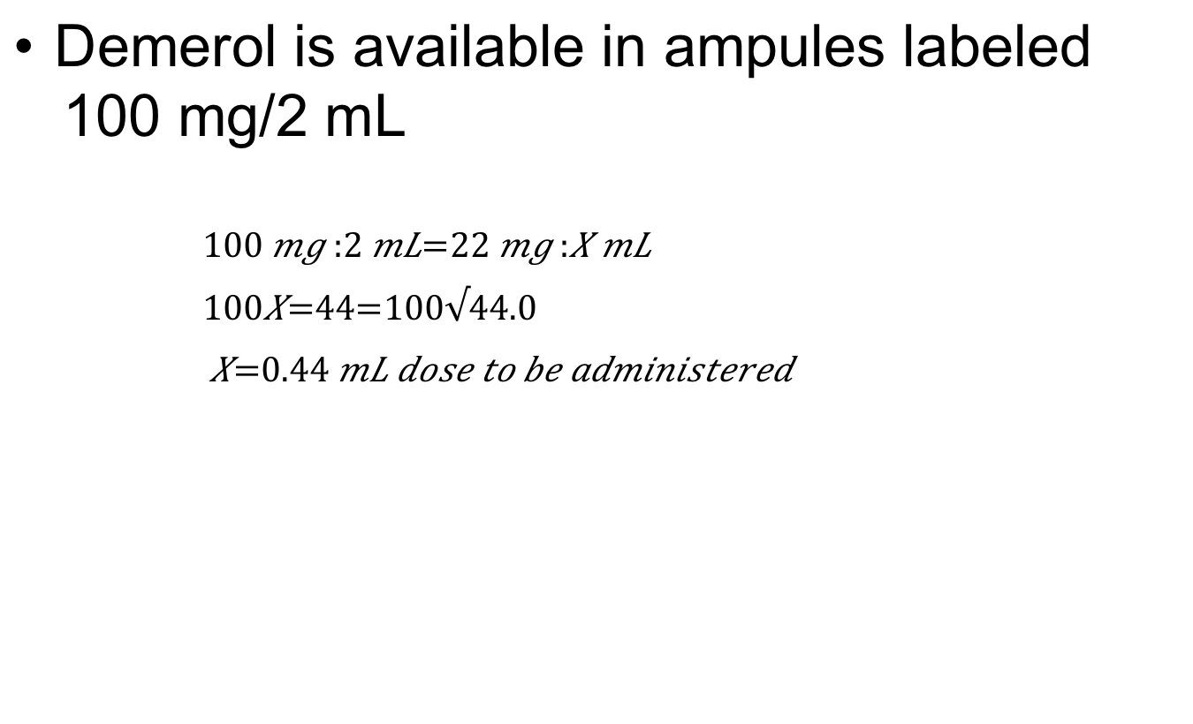
Pediatric Dosage (cont’d.)
Demerol is available in ampules labeled 100 mg/2 mL
      $$100 mg :2 mL=22 mg :X mL$$
      $100X=44=100√44.0$
      $X=0.44 mL dose to be administered$

Slide 19
Geriatric Dosage
Give special consideration to preparation and administration of safe dosage to older adults
  The dose frequently needs to be reduced
Several factors lead to possible dangerous cumulative effects
  Slower metabolism, poor circulation, or impairment of liver, kidneys, lungs, or central nervous system

Slide 20
Geriatric Dosage (cont’d.)
No formula can guide you in safe geriatric dosage
  Assess carefully on an individual basis, monitor constantly, and reduce dosage whenever possible

Slide 21
Prevention of Medication Errors
Medication errors
  Can occur for a number of reasons
How can these errors be prevented?
  Never leave the decimal point naked
  Never place a decimal point and zero after a whole number
  Avoid using decimals whenever whole numbers can be used as alternative

Slide 22
Prevention of Medication Errors (cont’d.)
  Have a second qualified person double-check any calculations for accuracy
  If you have difficulty interpreting the spelling of a drug name or the number used for the dosage, or the dosage seems inappropriate, always question the order

